Slide 1








How To Write Up A Proposal
Fahad Almsned, MD, PhD, MAS
Director, Advanced Analytics and Predictive Modelling at Eastern Health Cluster (E1)
Director, Research Operations at KFSH-D
Institutional Review Board (IRB) Chairperson at KFSH-D
Associate Consultant of Bioinformatics at KFSH-D
Affiliated Graduate Faculty at George Mason University
R&D Consultant and Member of the Board of Advisors at GeneoClinic
Health Track Lead, Artificial Intelligence Governance Association

Slide 2
Definition
It is a document that describes WHAT you will do, WHY it should be done, and HOW you will do it.
Examples
Evaluating the Efficacy of Remote Monitoring for Chronic Heart Failure Patients
Genomic Predictors of Response to Immunotherapy in Melanoma
The Role of Wearable Fitness Technology in Improving Physical Activity Levels in Obese Adolescents

Slide 3
The WHAT
The project will identify genomic biomarkers that predict the efficacy of immunotherapy in melanoma patients.

Slide 4
The WHY
Melanoma is a highly aggressive form of skin cancer with variable responses to immunotherapy. Identifying genomic predictors will allow for precision medicine approaches, tailoring treatments to individuals based on their genetic profile. This could enhance treatment effectiveness, reduce adverse effects, and optimize healthcare resources. The significance of this research is rooted in improving survival rates and quality of life for melanoma patients.

Slide 5
The HOW
Patient Selection and Data Collection: Recruit melanoma patients from multiple centers prior to starting immunotherapy. Collect comprehensive clinical data and tissue samples.
Genomic Analysis: Perform high-throughput sequencing to identify genetic variants across the collected samples.
Data Processing and Analysis: Use bioinformatics tools to analyze sequence data, identify significant genetic markers, and correlate them with treatment responses recorded in clinical follow-ups.
Validation: Validate findings in a separate cohort to ensure reliability and applicability across diverse populations.
Dissemination: Share results through scientific publications and presentations at medical conferences, and engage with pharmaceutical companies for potential clinical application.

Slide 6
Understand The WHY?
What are the functions of the research proposal?
1. Communicate (clearly and concisely) the details of your research.
2. Convince the reader to approve it.
Convincing is a Key

Slide 7
What Do You Need to Convince The Reader of?
1
2
3
Articulation
Justification
Do-ability
That your research focus is crystal clear and well defined
That your research is well-justified, unique, and worthwhile.
That your research is realistic and achievable (Time - Money - Skills)

Slide 8
The Ingredients
Provisional Title
Introduction and The Research Problem
Literature Review
Research Design (Methodology)
Reference List
Practicalities

Slide 9
#1 Provisional Title
Don't get too stuck to produce the perfect research title.
Specific requirements for the title (e.g., limitations in wording).
A good title concisely communicates what your research is all about.

Slide 10
#1 Provisional Title
Examples:
“Preoperative Anxiety in Children.”
“The effects of a counseling program by nurses on preoperative anxiety in children undergoing tonsillectomy in KFSH-D; A cross-sectional study.”

Slide 11
#1 Provisional Title
“The effects of a counseling program by nurses on preoperative anxiety in children undergoing tonsillectomy in KFSH-D; A cross-sectional study.”
What does it communicate?
Broad topic: preoperative anxiety management; focal topics: Nurse-Led Counseling and children undergoing tonsillectomy; context: preoperative care for children undergoing tonsillectomy at KFSH-D; intervention: a counseling program by nurses; methodology: cross-sectional; Target Population: children undergoing tonsillectomy.

Slide 12
#2 Introduction and The Research Problem
Intro Chapter
Provide a broad overview of the topic, then narrow it down to your focal topic.
Scope: Ringfence your research - Rabbit hole - Narrow your focus.
Make it clear what you will be focusing on and what you will exclude.
Focus on the WHY (Rationale, The GAP), not only the WHAT
No research in your country or industry.
Exciting research is outdated.
Exciting research has methodological issues.

Slide 13
#3 Literature Review
Connecting the exciting research to yours
Show that you know the exciting research
Reveal the gap in the exciting research
A literature review is not a history lesson (Avoid Descriptive Writing)
It needs to be analytical, not just descriptive (Link)
Think about it as an argument. How has that developed over time?

Slide 14
#4 Research Design (Methodology)
It is about explaining the HOW of your research in details.
Like the title, the design might change as you undertake the research
Your data results will push you to undertake a different analysis
You wouldn't want to switch drastically (e.g., a quantitative study to a qualitative study)
Always Consult with an expert regarding your research design before submitting (very expensive)

Slide 15
#4 Research Design (Methodology)
Philosophy
Approach
Sampling
Data type(s)
Collection methods
Analysis technique

Slide 16
#5 Reference List
Referencing is a key research skill
Academic → 100% on-the-point referencing is a must.
Check for the required style (e.g., Harvard or APA style)
Always use reference management software (e.g., Mendeley, Zotero, EndNote) (Link)
Never do it manually.
Reference throughout your proposal, not just the literature review.

Slide 17
#6 Practicalities
Anything related to the practical components, the implementation, and the pulling off your research project.
Project plan (Gantt chart)
Resource plan (budget, physical resources...etc.)
Risk management
Ethical compliance

Slide 18
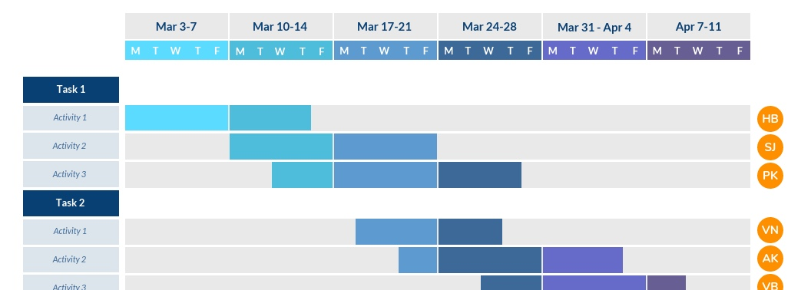
#6 Practicalities
Gantt chart (Link)

Slide 19
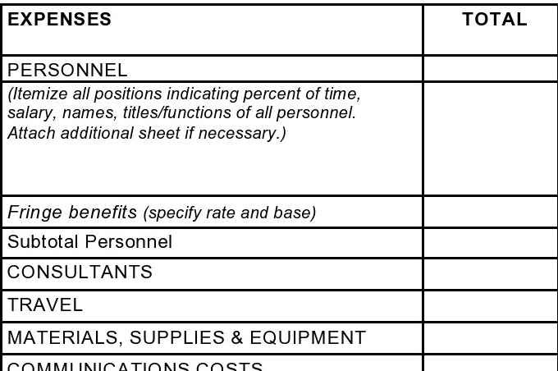
#6 Practicalities
Budget

Slide 20



Together for a healthier world
Thank You!
Almsned.fahad@gmail.com
https://twitter.com/Fahad_Almsned
https://www.linkedin.com/in/fahad-almsned

